Slide 1




Week-10 (Discussion)
23th Sept, 2025
Computer Vision
Prof. Jayanta Mukhopadhyay
Professor
Computer Science and Engineering Department
IIT Kharagpur
Ayan Paul
PMRF Research Scholar
IIT Kharagpur

Slide 2
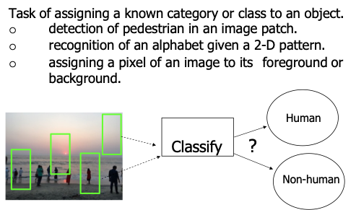
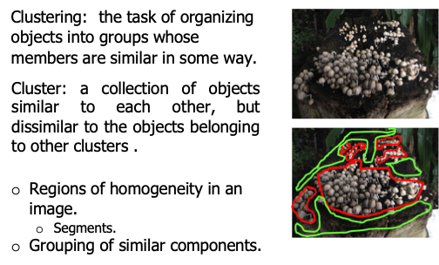
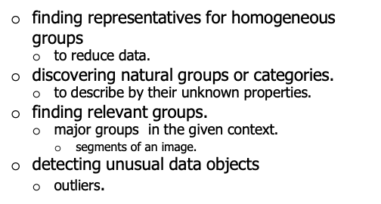
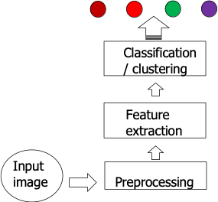
Classification
Clustering
Cluster
Class
A cluster: a group with ‘loosely’ defined similarity among the objects.
Potential to form a class.
A class: well studied group of objects identified by their common properties or characteristics.
Processing pipeline
Clustering: Motivation

Slide 3
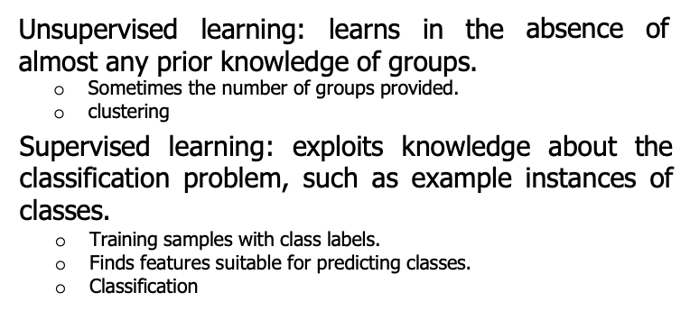
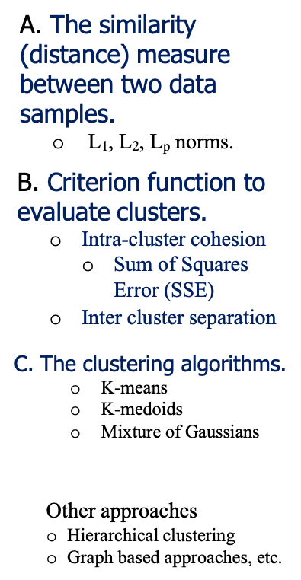
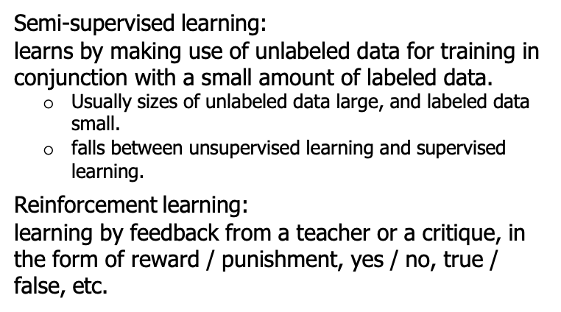
Types of Learning
Clustering: Three major components

Slide 4
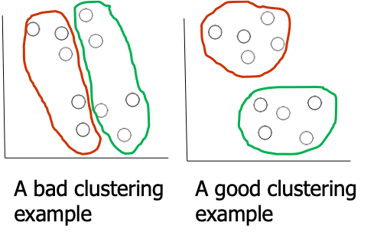
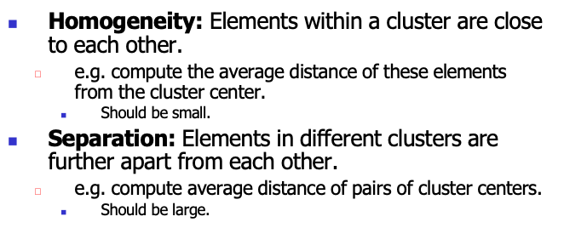
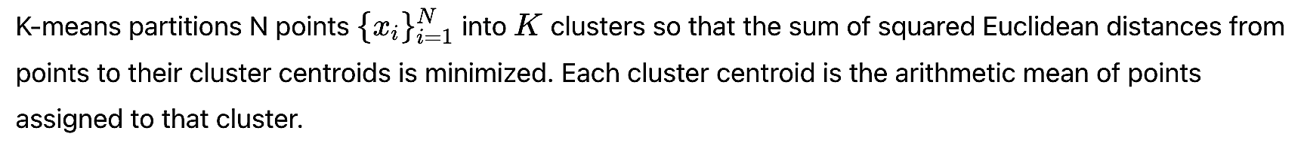
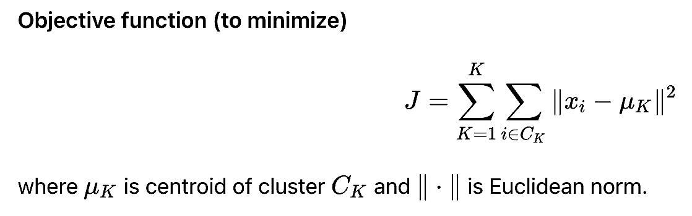
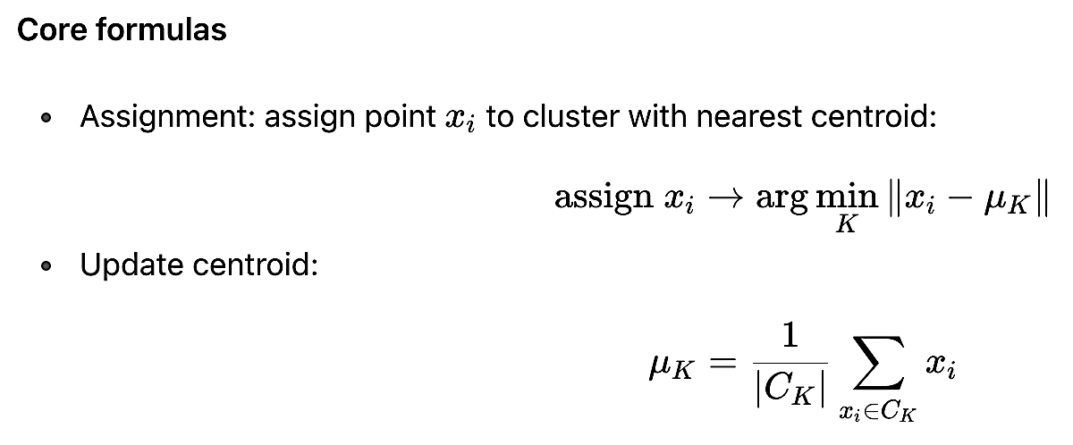
Homogeneity and Separation Principles
K-means clustering

Slide 5
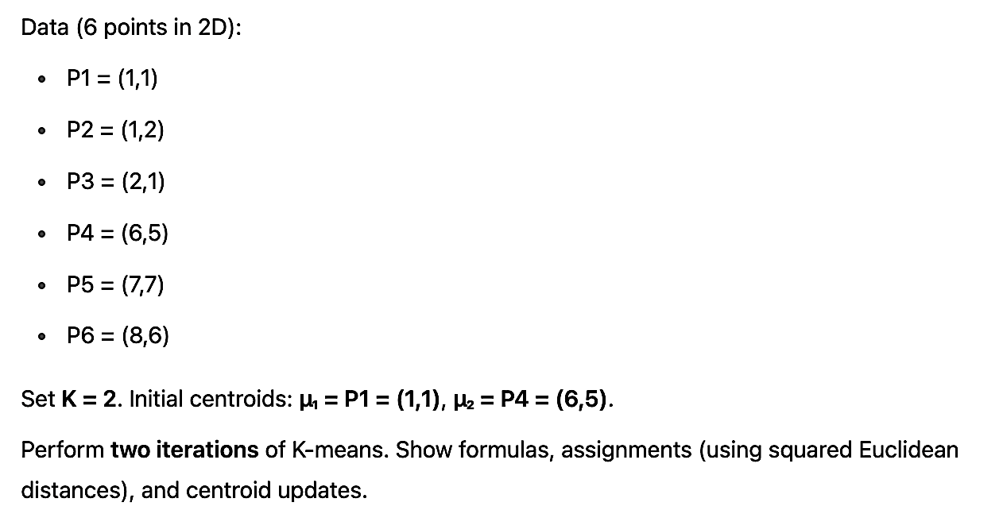
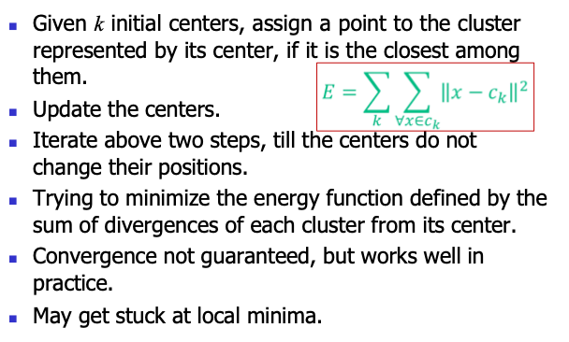
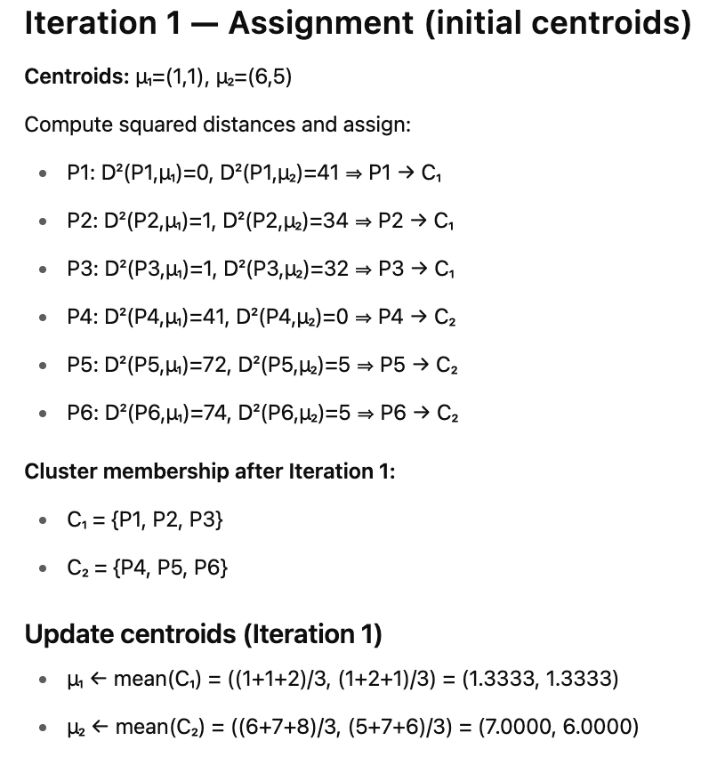
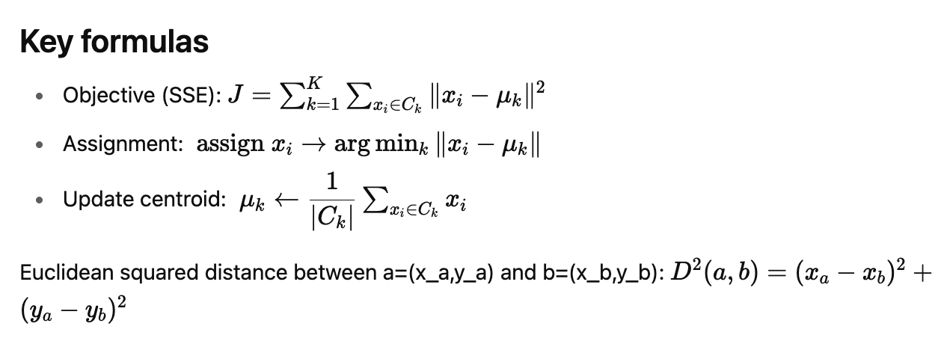
The Lloyd algorithm (K-mean steps)
Exercise - 1
Solution

Slide 6
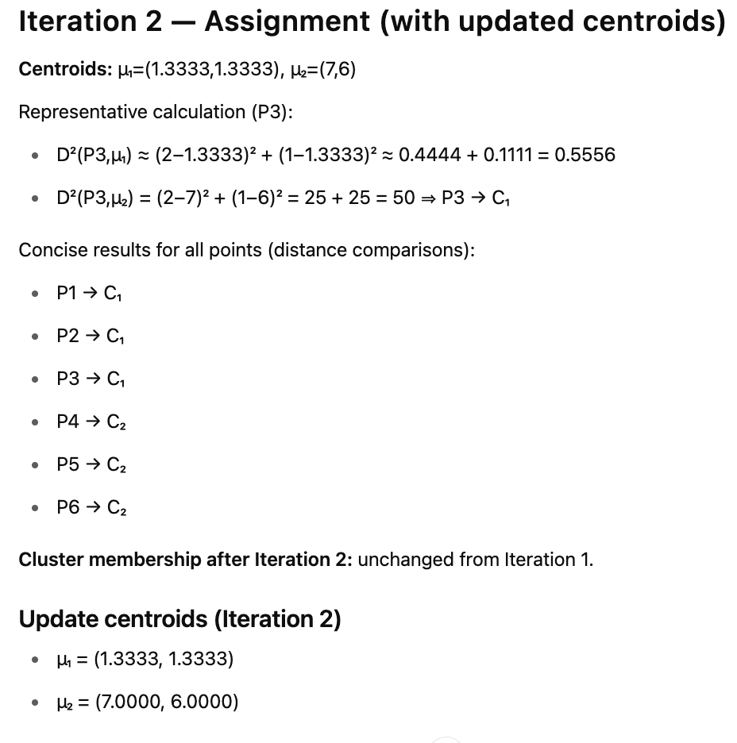
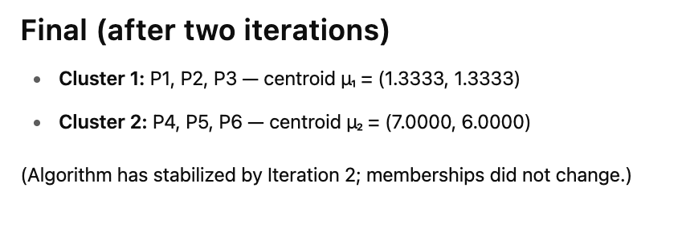

Slide 7
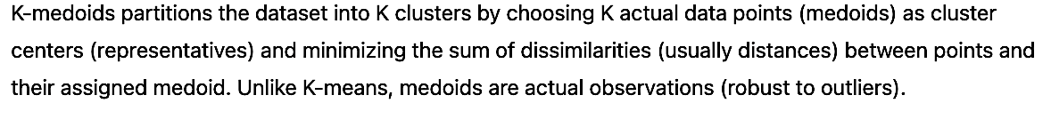
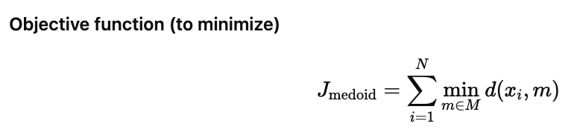
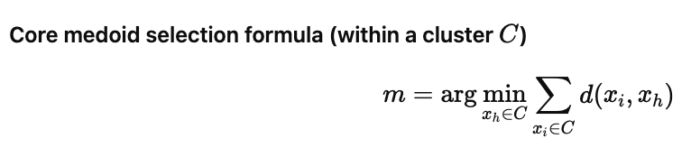
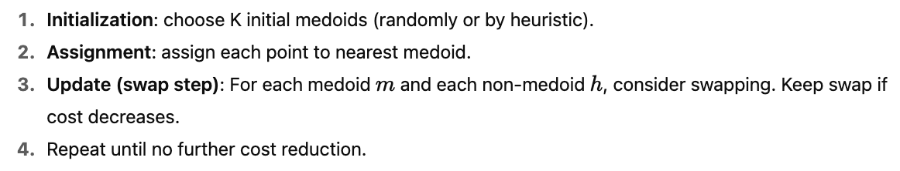
K-Medoids clustering (a.k.a. Partitioning Around Medoids, PAM)
The PAM algorithm steps

Slide 8
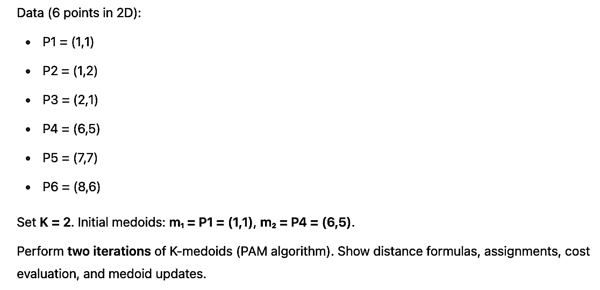
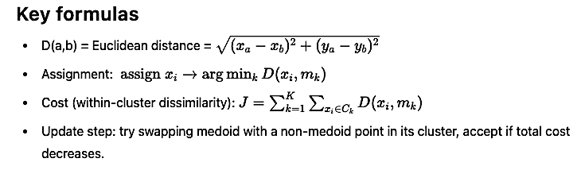
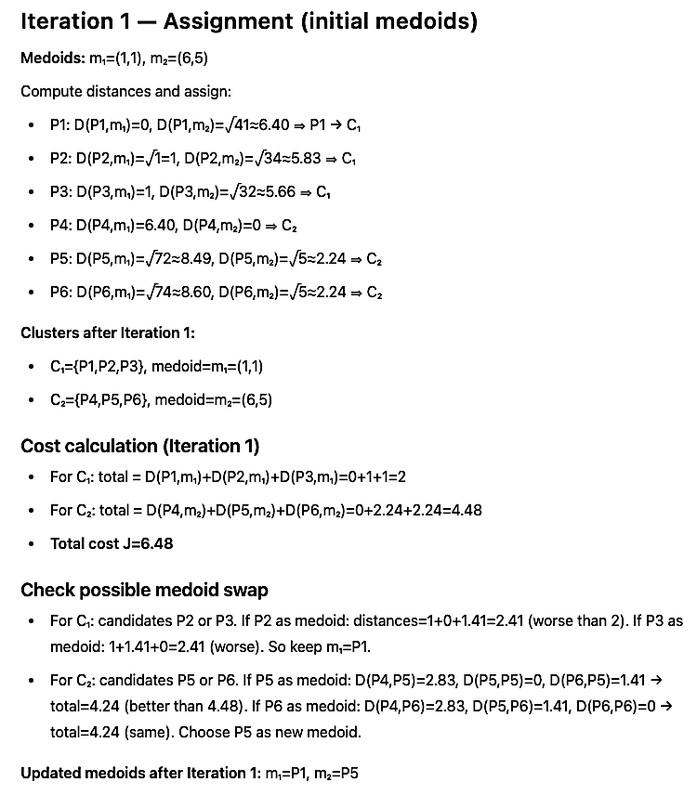
Exercise - 2
Solution

Slide 9
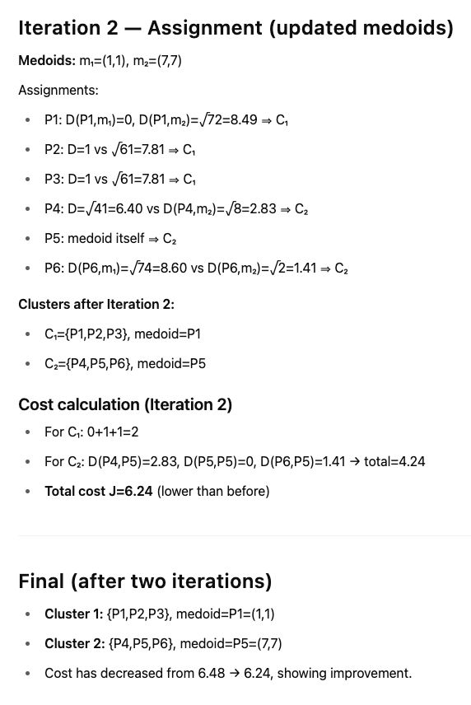
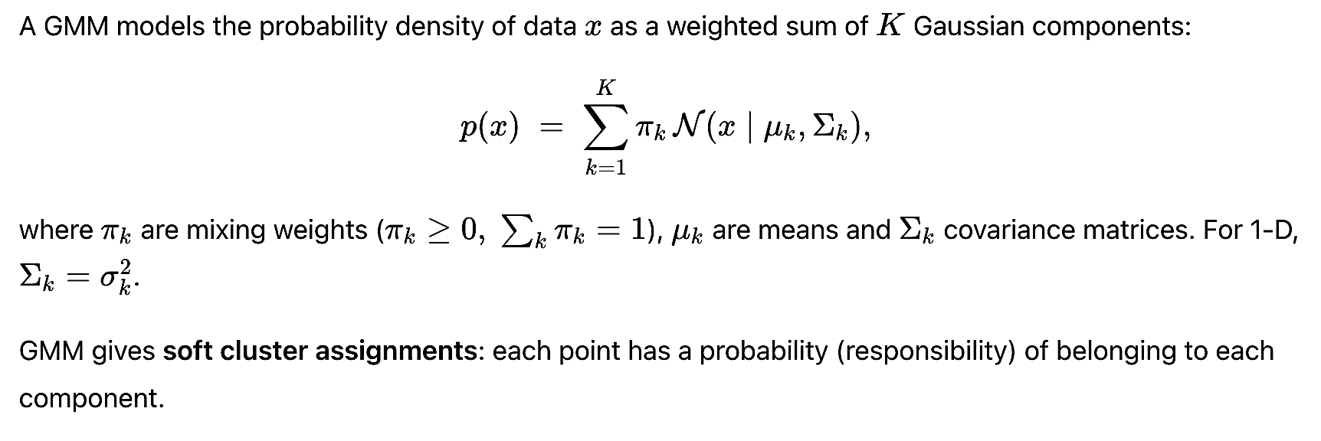
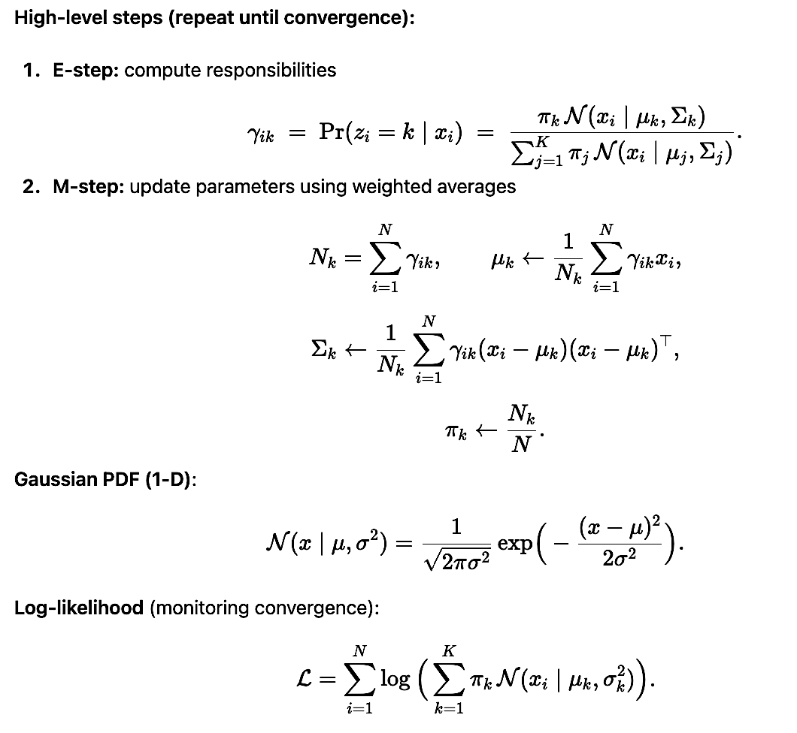
Mixture of Gaussians (GMM)
Expectation–Maximization (EM) for GMM

Slide 10
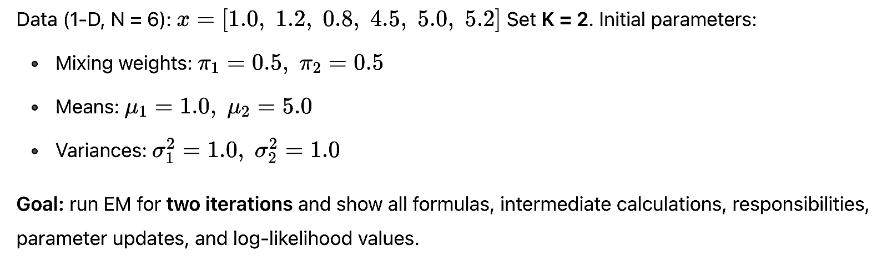
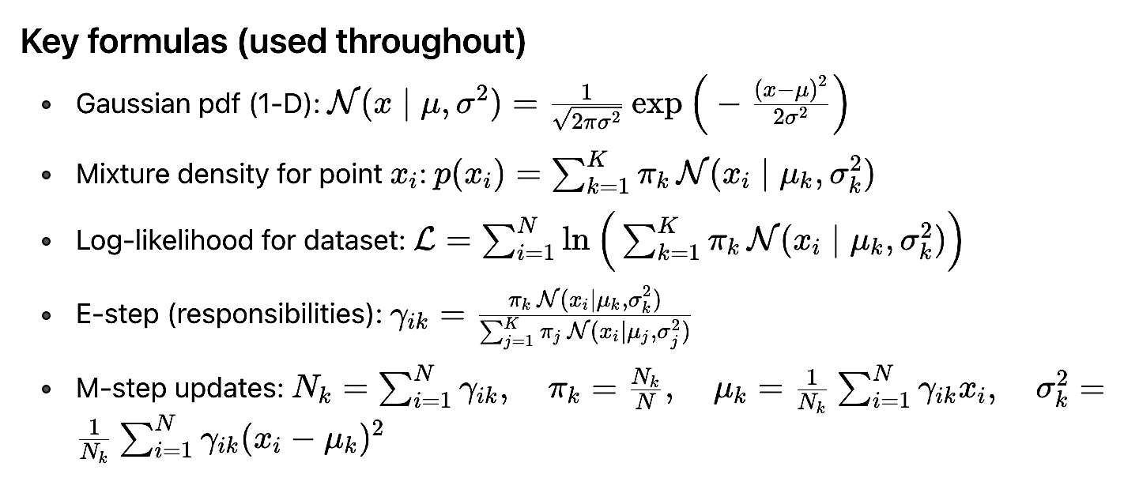
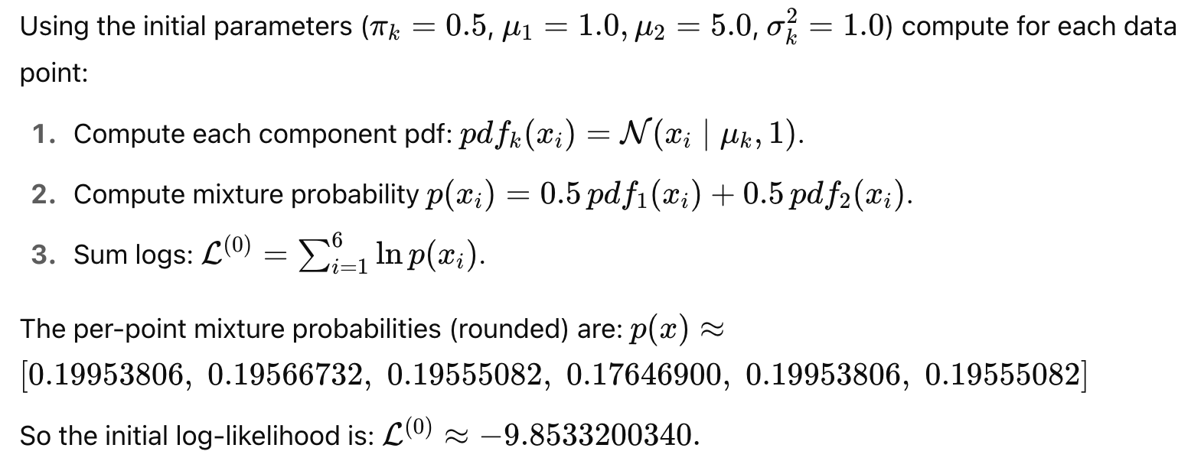
Exercise - 3
Solution

Slide 11
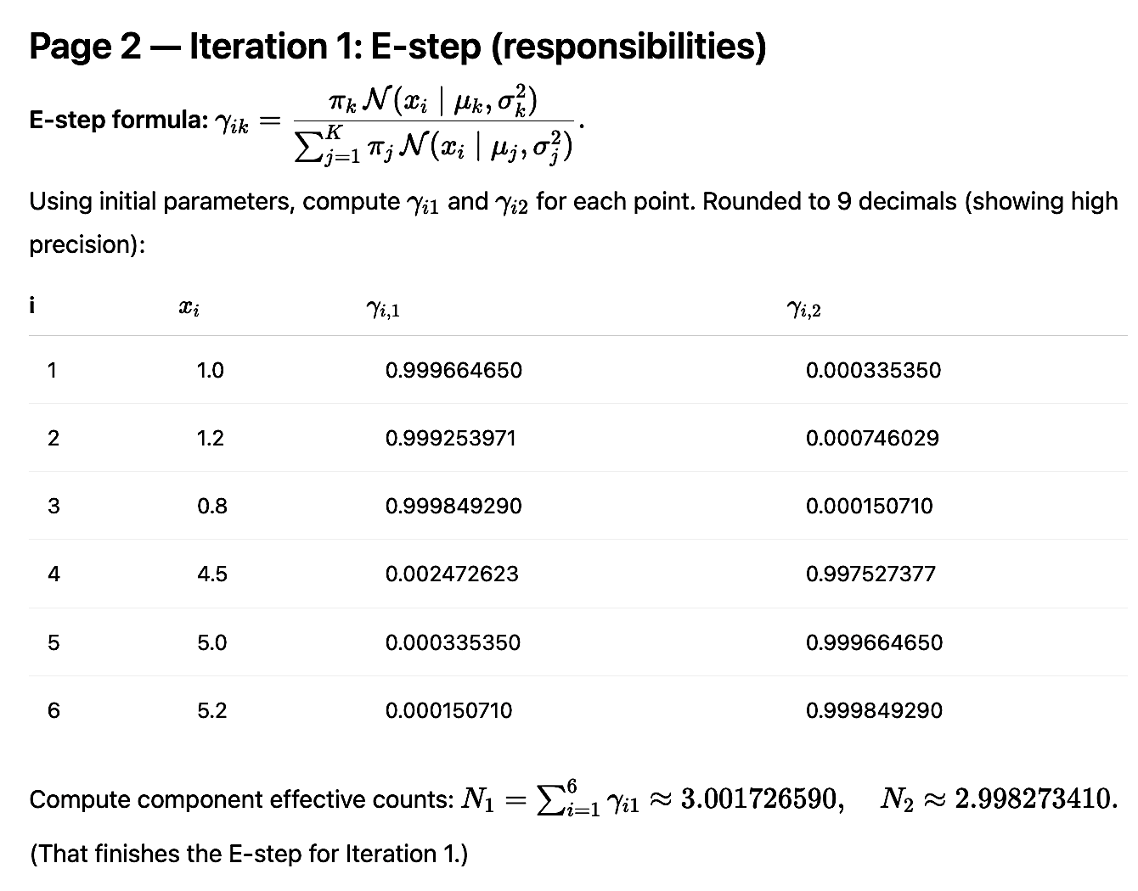
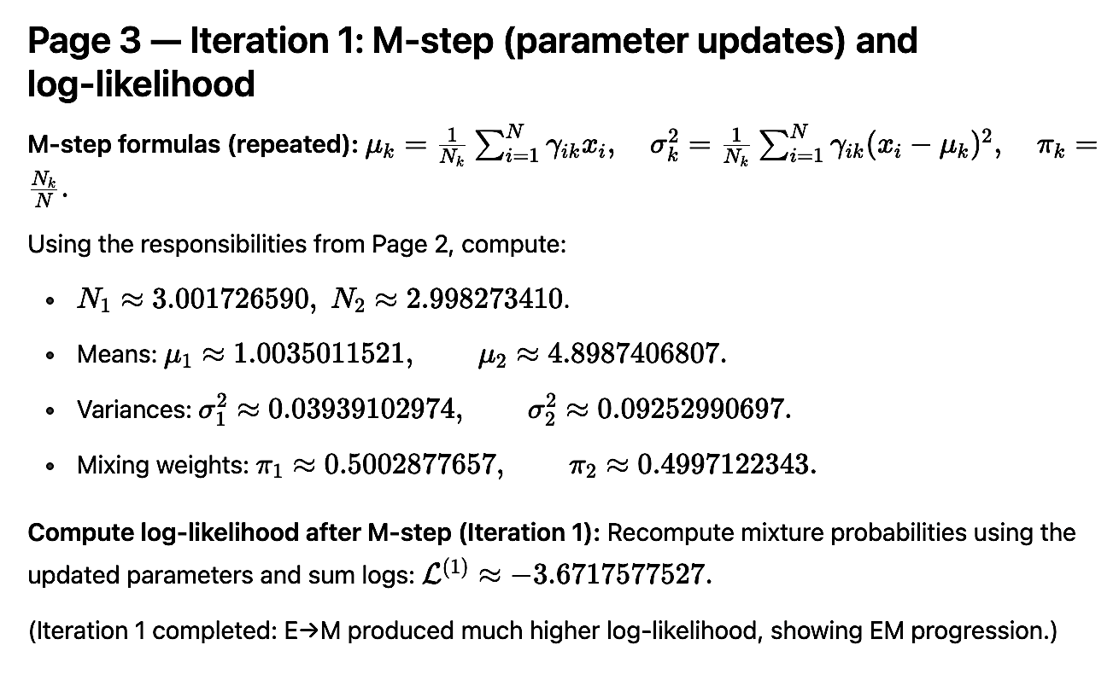
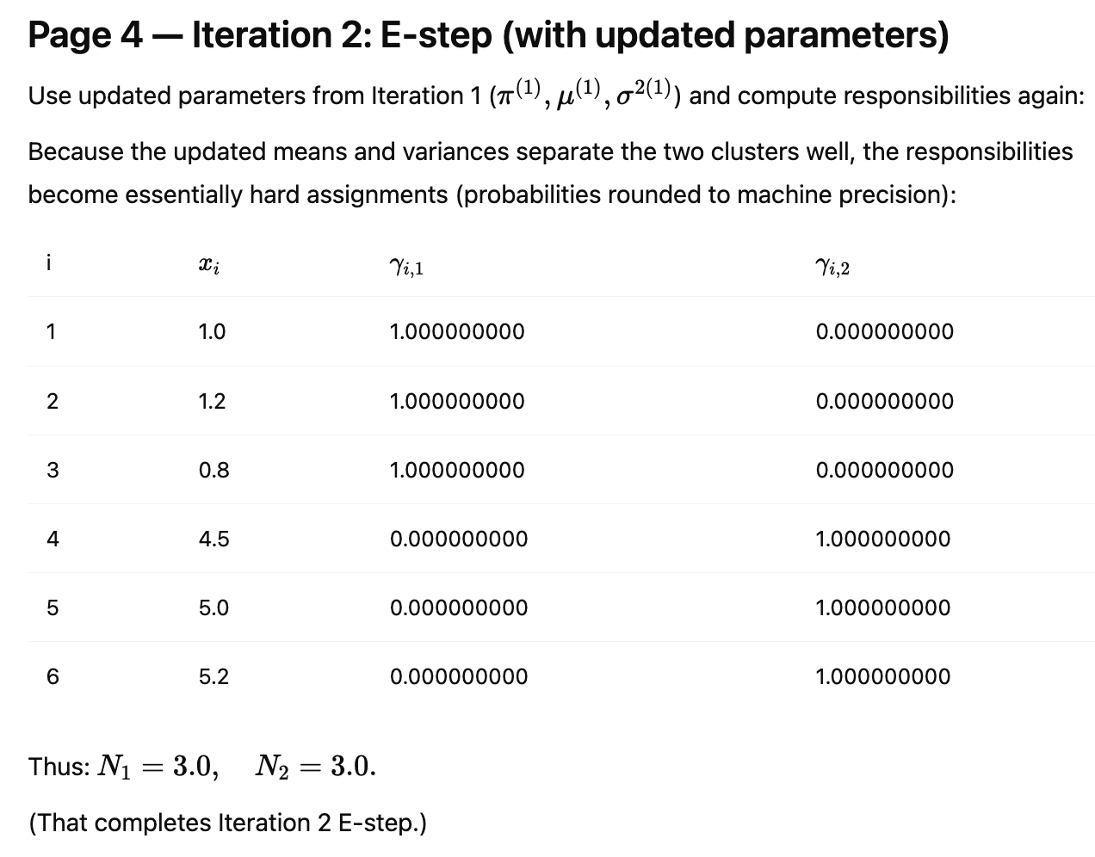
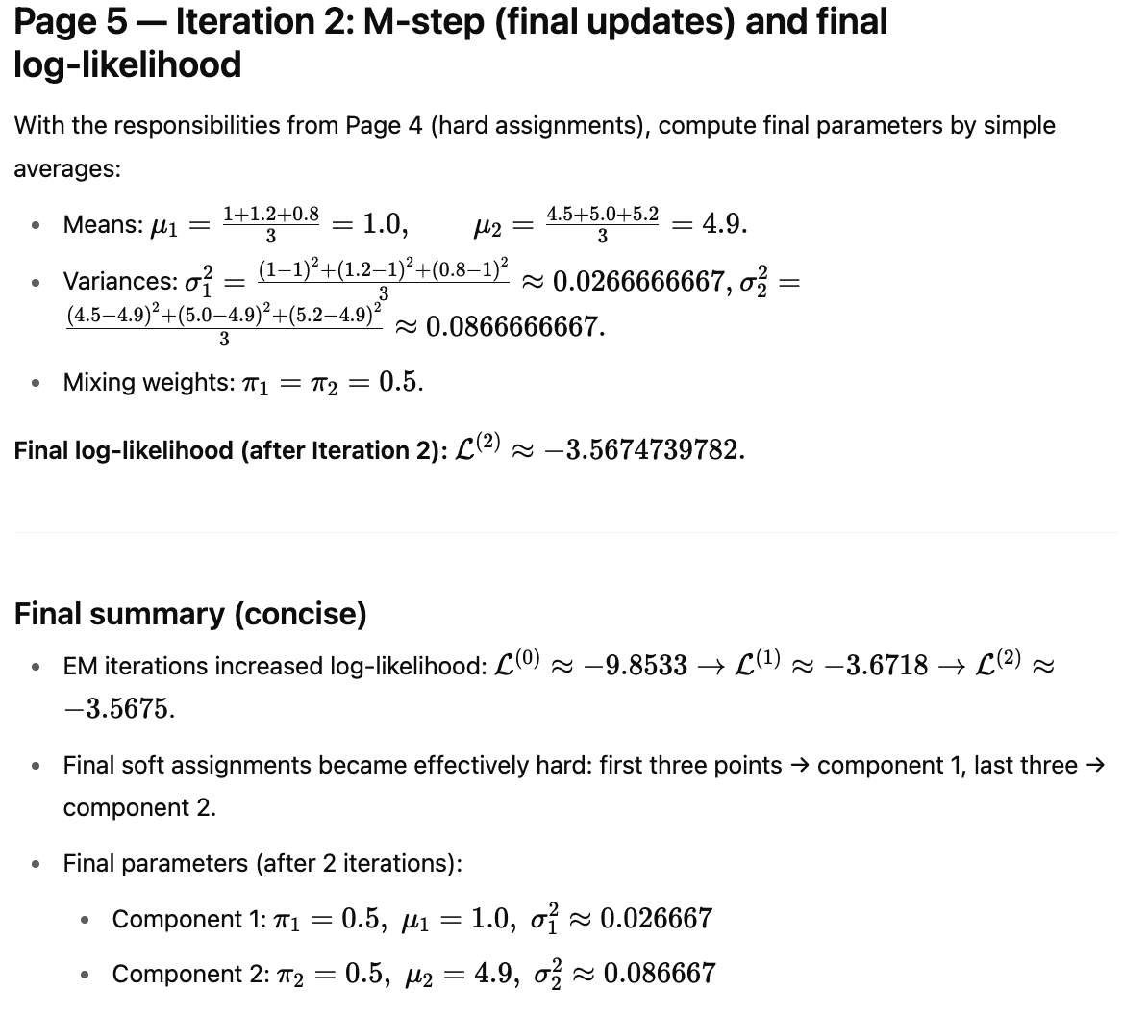

Slide 12

Interested More in Clustering Concepts and Problems?
Refer these links
https://docs.google.com/presentation/d/15qzc_y8s28iX7eNR1YmL6UVRvbydg7fhzRb1jrvdqOQ/edit?usp=sharing
https://docs.google.com/presentation/d/1-VNW8XFzLzwRSiicQHRcfSjNq75K_VvG-WTHIXNKJA0/edit?usp=drive_link

Slide 13
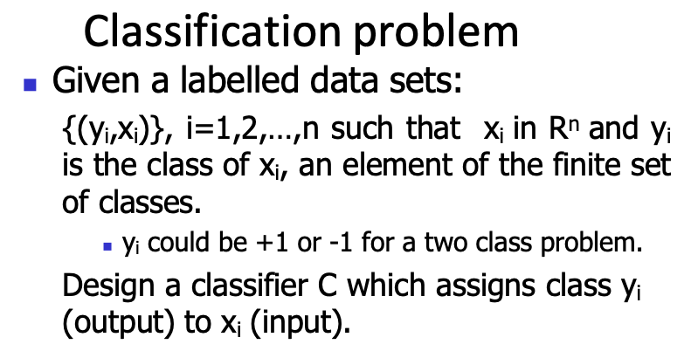
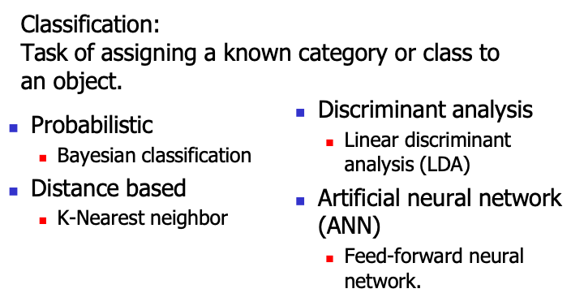
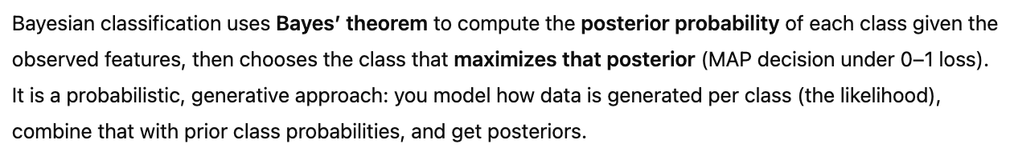
Classification approaches
Bayesian Classification

Slide 14
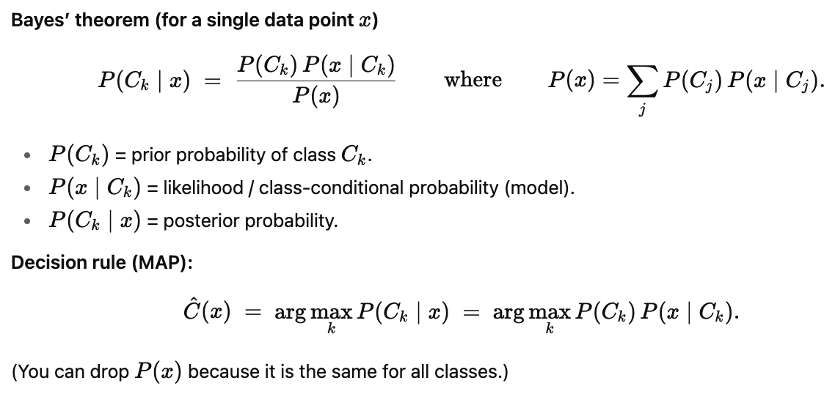
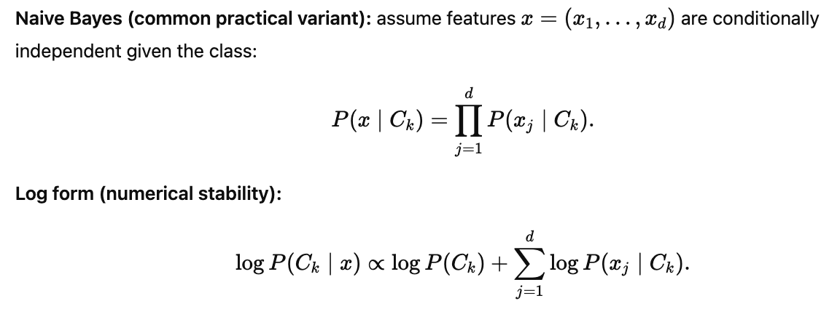
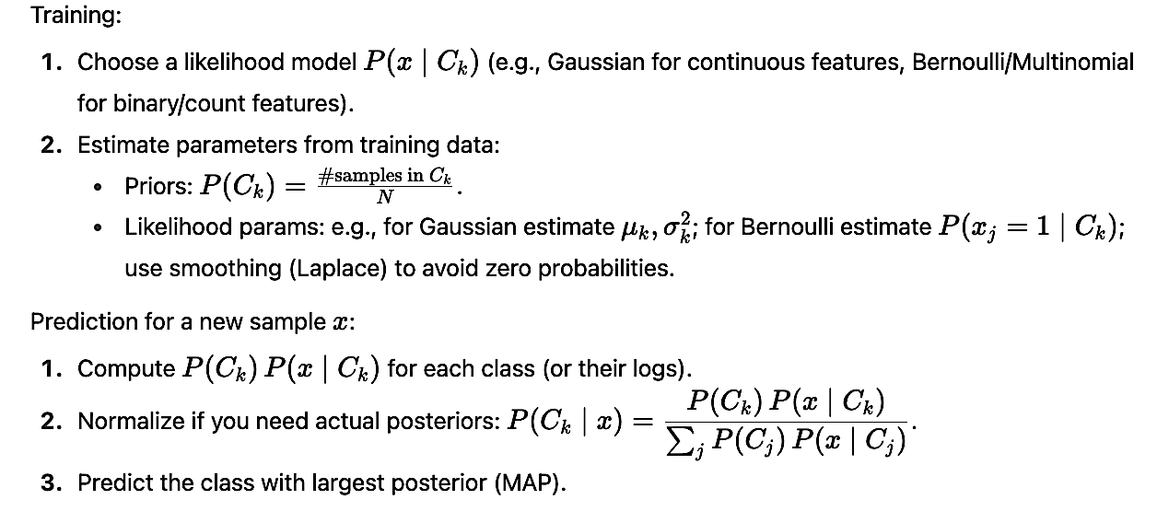
Bayes’ theorem (for a single data point x)
Naive Bayes
Steps to build & use a Bayesian classifier

Slide 15
Exercise - 4
 | age | income | student | redit_rating | _com
 | <=30 | high | no | fair | no
 | <=30 | high | no | excellent | no
 | 31…40 | high | no | fair | yes
 | >40 | medium | no | fair | yes
 | >40 | low | yes | fair | yes
 | >40 | low | yes | excellent | no
 | 31…40 | low | yes | excellent | yes
 | <=30 | medium | no | fair | no
 | <=30 | low | yes | fair | yes
 | >40 | medium | yes | fair | yes
 | <=30 | medium | yes | excellent | yes
 | 31…40 | medium | no | excellent | yes
 | 31…40 | high | yes | fair | yes
 | >40 | medium | no | excellent | no
Class: C1:buys_computer = ‘yes’ C2:buys_computer = ‘no’
Data to be classified: X = (age <=30,
Income = medium, Student = yes Credit_rating = Fair)

Slide 16
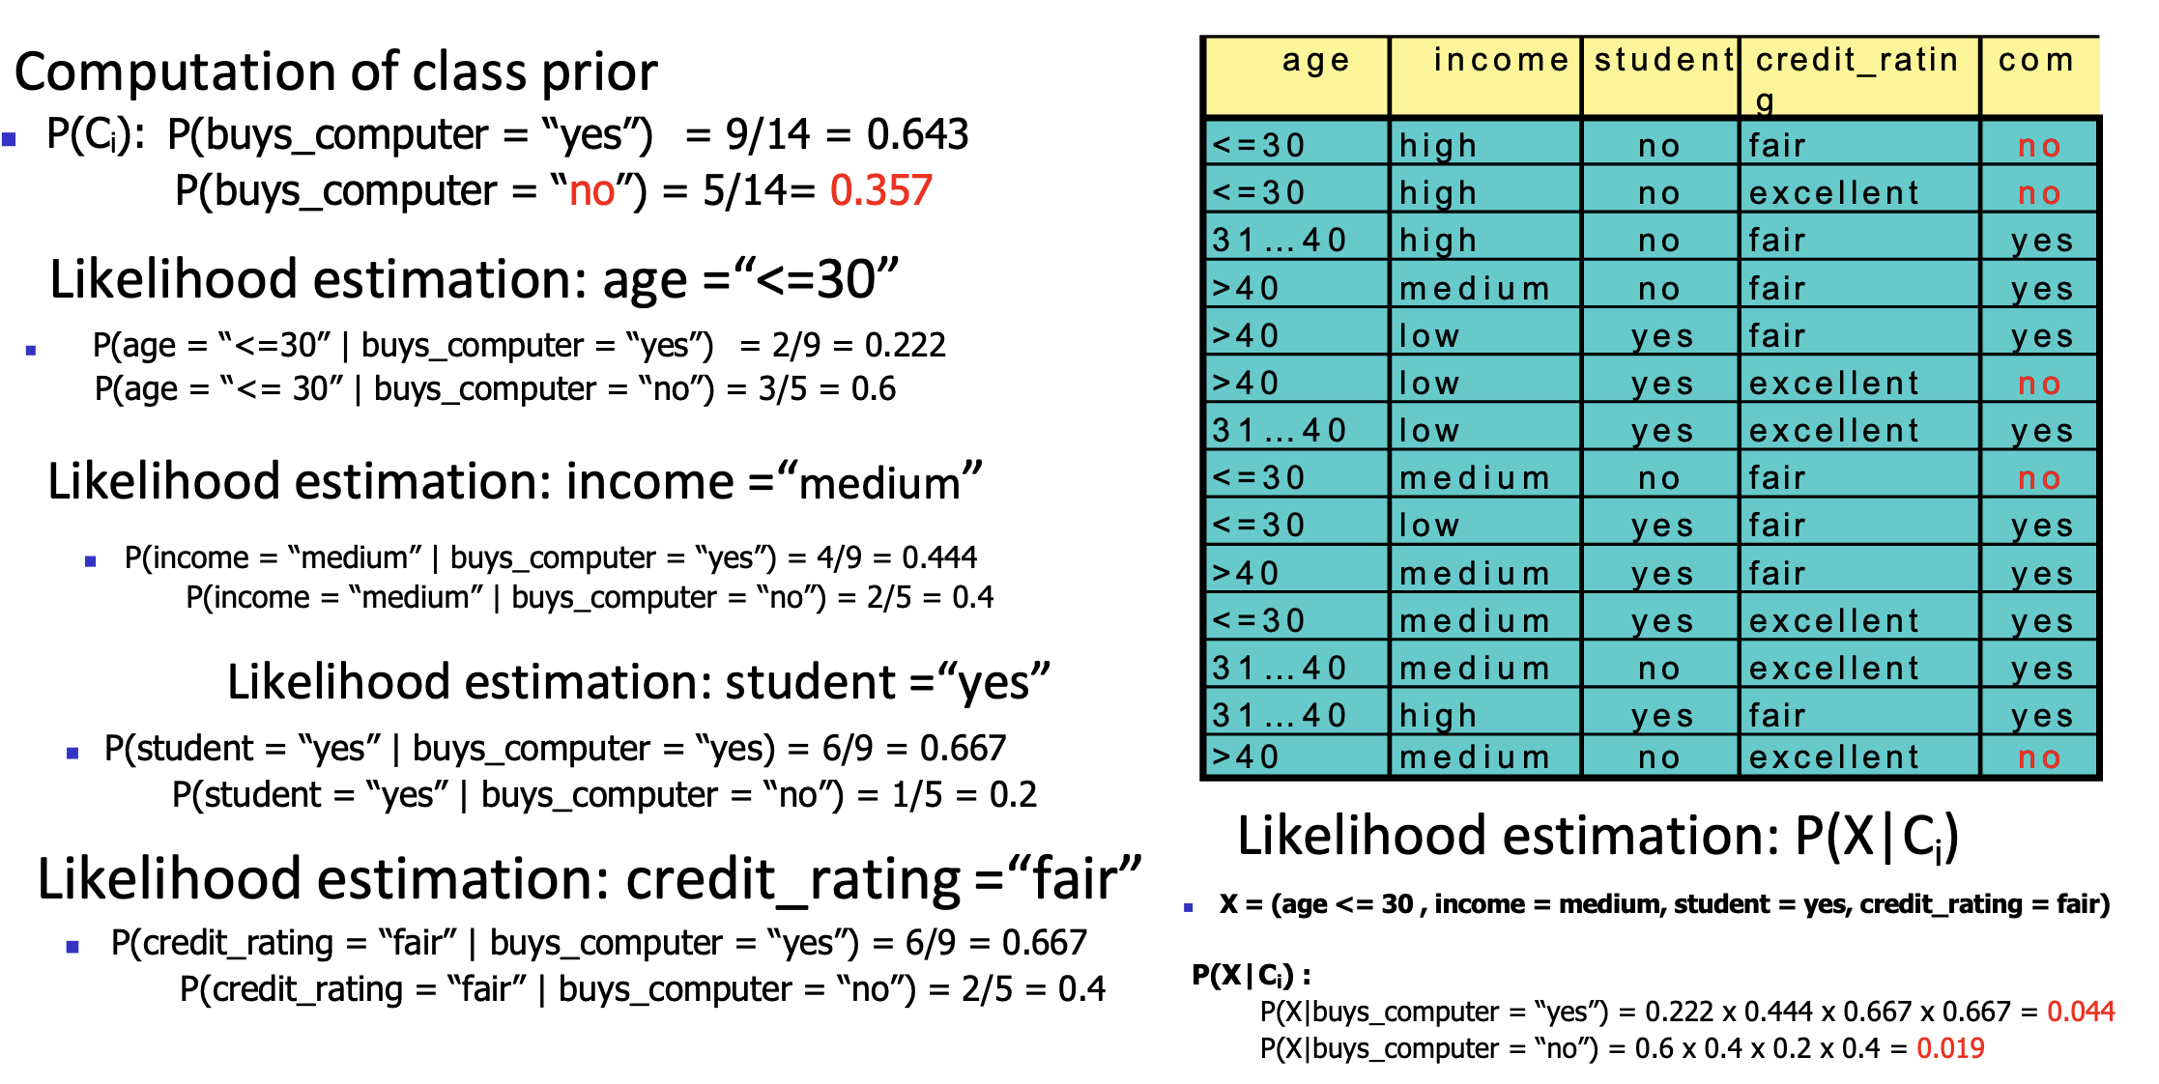
Solution

Slide 17
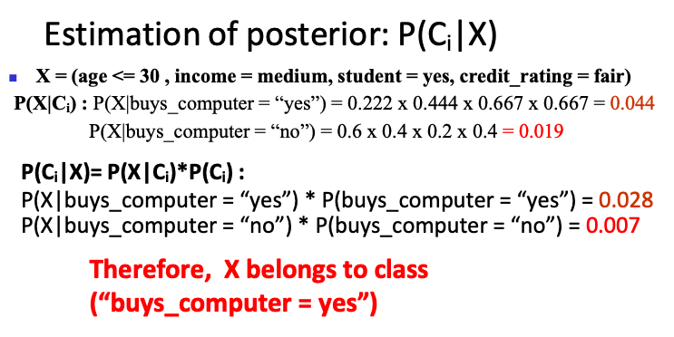
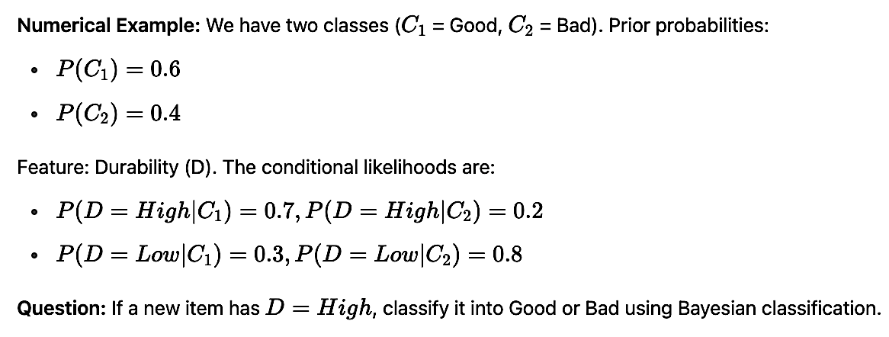
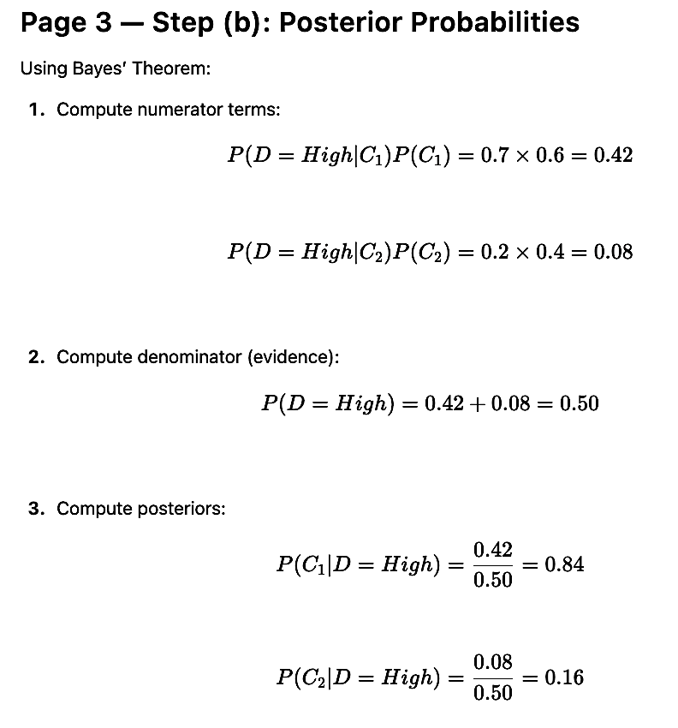
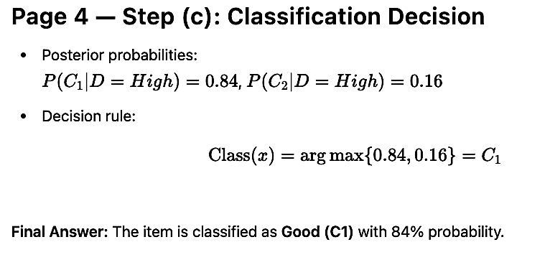
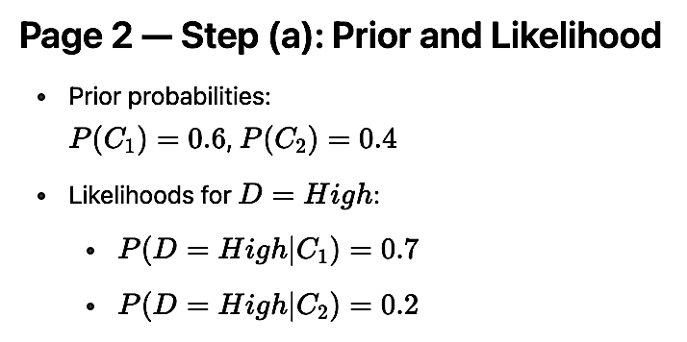
Exercise - 5
Solution

Slide 18
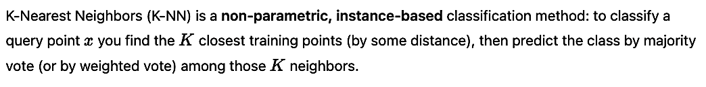
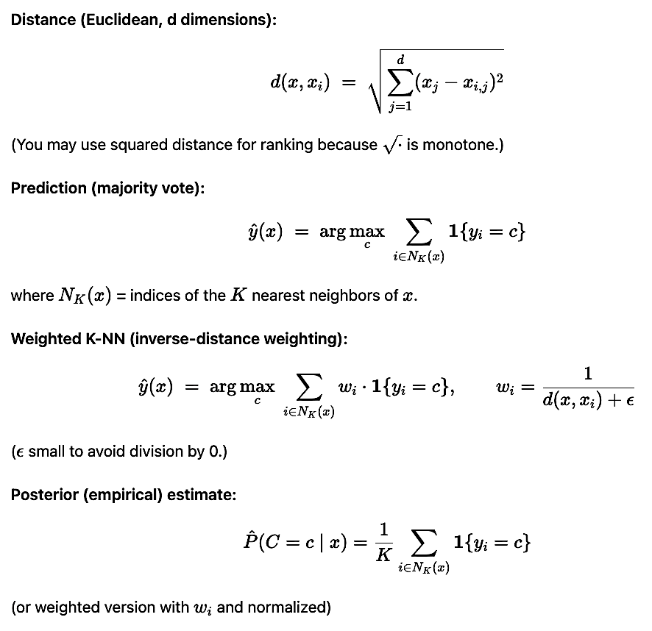
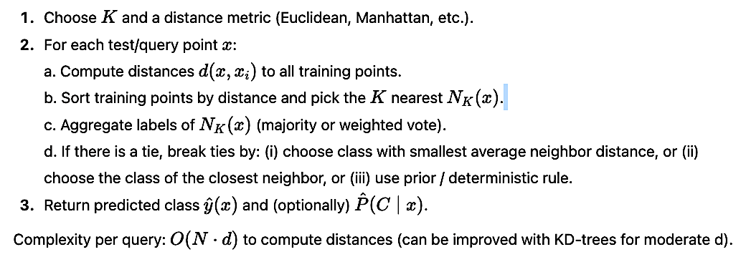
K-Nearest Neighbor (K-NN) Method
Algorithm (steps)

Slide 19



Exercise - 6
Solution

Slide 20



Linear discriminant analysis (LDA) from Bayes’ classifier
Training / prediction steps (practical)

Slide 21





Exercise - 7
Solution

Slide 22




Slide 23




Perceptron classifier

Slide 24




Exercise - 8
Solution

Slide 25



Perceptron modelling a neuron
Training / prediction steps (practical)

Slide 26


Exercise - 9
Solution

Slide 27




Artificial neural network (Multi-layered feedforward classifier)

Slide 28




Exercise - 10
Solution

Slide 29



Slide 30



Slide 31



Slide 32



Artificial neural network (Multi-layered feedforward regressor)

Slide 33



Exercise - 11

Slide 34



Solution

Slide 35



Slide 36





Slide 37

Key Differences Between ANN Classifier and Regressor

Slide 38


Evaluation of a classifier
The confusion matrix is a way to visualize how many samples from each label got predicted correctly.
Two class problems.
Positive class and Negative class
TP: Set of +ve samples predicted +ve.
FP: Set of –ve samples predicted +ve.
TN: Set of –ve samples predicted –ve.
FN: Set of –ve samples predicted +ve.

Slide 39

Cross Validation
The idea of cross validation arises because of problems with train test models. It basically wants to guarantee that evaluation of our model does not depend upon the way we pick the train and test set.

Slide 40
Topics on which Week 10 Assignment Questions are based
Types of Learning
Clustering – K-Means, K-Medoids, Gaussian Mixture Model
Classification – Bayesian Classifier, K-Nearest Neighbor Classifier, Linear discriminant analysis (LDA) from Bayes’ classifier, Perceptron classifier, Artificial neural network (Multi-layered feedforward classifier and Regressor).
Evaluation of a classifier
Cross Validation

Slide 41


QUESTION 1
Which of the following statements are true for an Artificial Neural Network?
a) A single neuron with two inputs and the signum activation function can implement an AND gate.
b) A single neuron with two inputs and the signum activation function can implement an XOR gate.
c) A single neuron with multiple inputs and the signum activation function acts as a linear discriminator in a multidimensional feature space for two linearly separable classes.
d) A single neuron with multiple inputs and the sigmoid activation function computes posterior of a class for a two-class classification problem in a multidimensional feature space.
SOLUTION 1
CORRECT ANSWER 1
a), c), d)

Slide 42



QUESTION 2
Consider the following table. The table shows the points on x-axis and its corresponding class.
We introduce two new points on x-axis, 3.7 and 4.2. Compute KNN (K=3) to determine their class.
a) 3.7 : Class 2 and 4.2: Class 1
b) 3.7 : Class 1 and 4.2: Class 2
c) 3.7 : Class 1 and 4.2: Class 1
d) 3.7 : Class 2 and 4.2: Class 2
SOLUTION 2
CORRECT ANSWER 2
b)

Slide 43



QUESTION 3
Assume, you have 5 types of objects with 3 attributes each as shown in the table. Consider object A and object C as the initial centroids.
What will be the elements in each clusters after the first iteration?
a) Cluster 1: A, B, E Cluster 2: C, D
b) Cluster 1: A, B Cluster 2: C, D, E
c) Cluster 1: A, E Cluster 2: B, C, D
d) Cluster 1: A, C Cluster 2: B, D, E
SOLUTION 3
CORRECT ANSWER 3
a)

Slide 44



QUESTION 4
The output of a neural network is [2, 4, 7, 1, 5]. Find the softmax probability for 7. Answer to 4 places of decimals.
SOLUTION 4
CORRECT ANSWER 4
0.8372

Slide 45


QUESTION 5
SOLUTION 5
Assume, you want to cluster 7 observations into 3 clusters using K-Means clustering algorithm. After first iteration clusters, C1, C2, C3 has following observations:
C1: (2,2), (4,4), (6,6)
C2: (0,4), (4,0)
C3: (5,5), (9,9)
What will be the cluster centroids if you want to proceed for second iteration?
a) C1: (4,4), C2: (2,2), C3: (7,7)
b) C1: (6,6), C2: (4,4), C3: (9,9)
c) C1: (2,2), C2: (0,0), C3: (5,5)
d) C1: (2,2), C2: (0,4), C3: (5,5)
CORRECT ANSWER 5
a)

Slide 46

Consider the following neural network. Ix : Inputs; Bx : Biases; Hx : Hidden Layers; Ox : Outputs.
If all the Activation Functions are ReLU, then answer the following question 6 and 7.

Slide 47



QUESTION 6
SOLUTION 6
What will be the output for Input [1, 1]?
a) O1 : 0, O2 : 0
b) O1 : 0, O2 : 1
c) O1 : 1, O2 : 0
d) O1 : 1, O2 : 1
CORRECT ANSWER 6
d)

Slide 48


QUESTION 7
What will be the output if sigmoid activation functions are used in the output layer instead of ReLU? Note: Hidden layer still has ReLU.
a) O1 : 0.731, O2 : 1
b) O1 : 0.731, O2 : 0.731
c) O1 : 0.5, O2 : 0.5
d) O1 : 1, O2 : 0.731
SOLUTION 7
CORRECT ANSWER 7
b)

Slide 49




QUESTION 8
Consider a multilayer feed forward network which takes a 10-D feature vector as input and produces a 2-D output vector. The network has one hidden layer with number of neurons 15. Please note that the input vector is the input to the first hidden layer. What is the dimension of the parametric space over which the optimization process would be carried out to train the network?
SOLUTION 8
CORRECT ANSWER 8
197

Slide 50



QUESTION 9
We want to classify whether a special wire is good or not. Consider the following table consisting of four samples.
We introduce a new wire with durability 3 and strength 7. Which of the following statements are true after computing KNN (K=3)?
a) (3, 7) is a bad wire.
b) The nearest sample to (3, 7) is at a distance of 4.
c) (3, 7) is a good wire.
d) The nearest sample to (3, 7) is at a distance of 3.
SOLUTION 9
CORRECT ANSWER 9
c), d)

Slide 51



QUESTION 10
Calculate cosine similarity between [7, 4, 8, 2] and [3, 21, 5, 1].
a) 0.5842
b) 0.4872
c) 0.2314
d) 0.0950
SOLUTION 10
CORRECT ANSWER 10
a)

